Slide 1
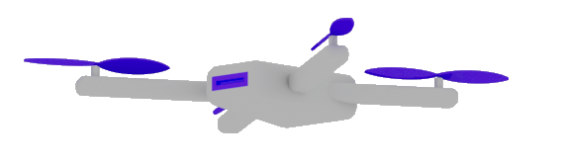
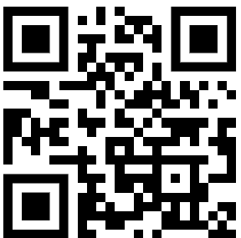
AI-AGENTS
Dr. Damir Dobric
Lead Software Architect daenet GmbH / ACP Digital
Microsoft Regional Director,
Most Valuable Professional: Azure + IoT

Slide 2
AGENDA
Demo – Lighting System
Agents (Foundry,..)
MCP Demo 2Sql
Vibe Coding
The Future

Slide 3

Software V2
The new Generation of Software
“After tomorrow”
“Tomorrow”
Quantum Computing
Software
Today
AI & Large Language Model Integration
Syntax Driven Languages

